Slide 1
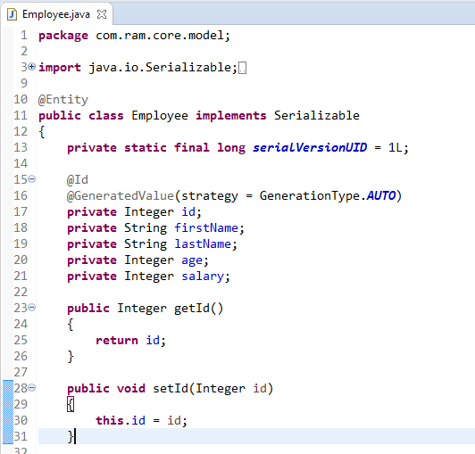
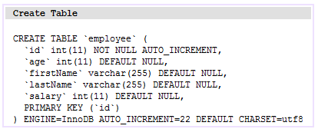
Spring Hibernate Integration Example
We learn how to integrate spring with hibernate. Spring is a J2EE framework and Hibernate is a ORM that is Object Relation Mapping Tool.

Slide 2
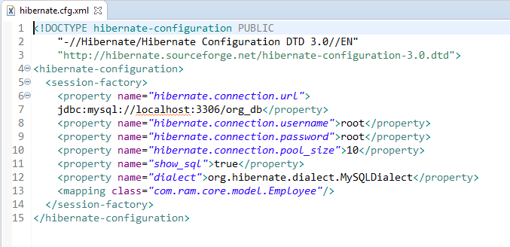
Spring Hibernate Integration Example
hibernate.cfg.xml is an XML which consists all the database configuration. Database name, POJO mapping, username, password and other database configurations has been declared in hibernate.cfg.xml.

Slide 3
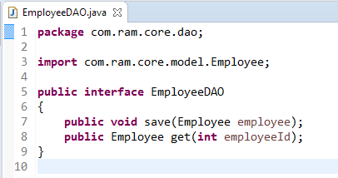
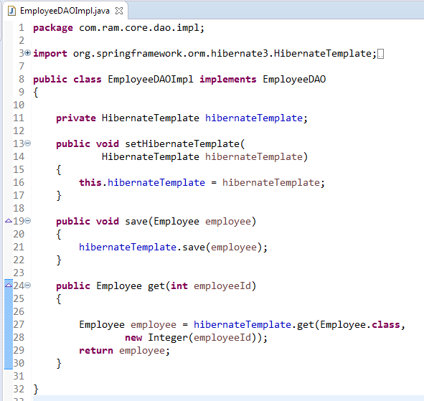
Spring Hibernate Integration Example

Slide 4
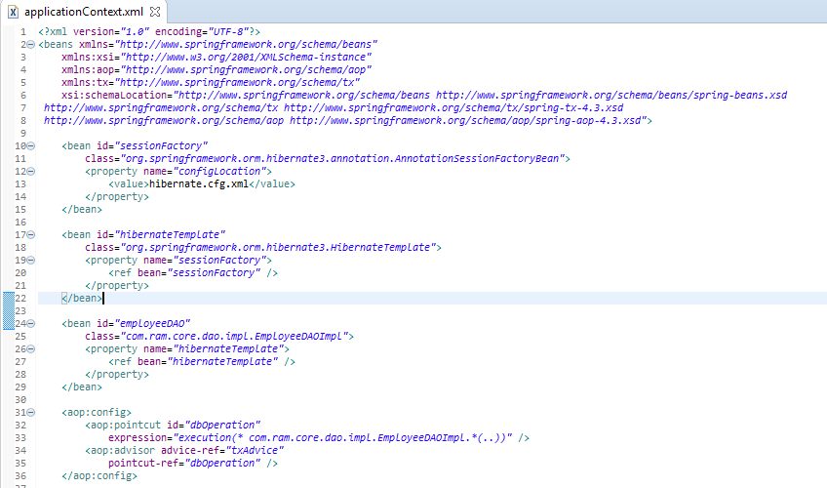
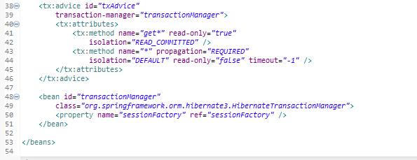
Spring Hibernate Integration Example

Slide 5
Spring Hibernate Integration Example
application.xml contains all the declaration of DAOs and other transactional configurations. For injecting HibernateTemplate to DAO classes, a bean of org.springframework.orm.hibernate3.HibernateTemplate has been created.
For the data integrity, we have used AOP, that will rollback the entry if any failure in transaction happens. The bean of org.springframework.orm.hibernate3.HibernateTransactionManager is playing the role of transactionManager and org.springframework.orm.hibernate3.annotation.AnnotationSessionFactoryBean is creating sessionFactory. To create sessionFactory, we are injecting hibernate.cfg.xml. sessionFactory is being injected to create transactionManager.

Slide 6
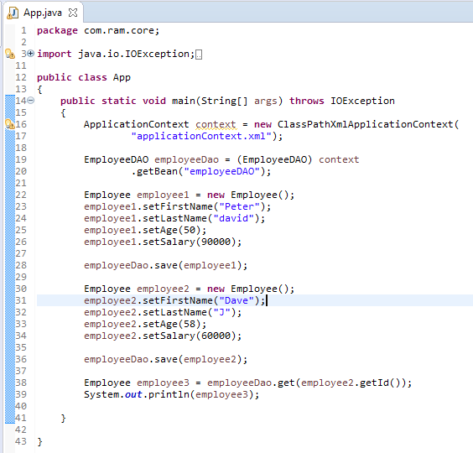
Spring Hibernate Integration Example

Slide 7
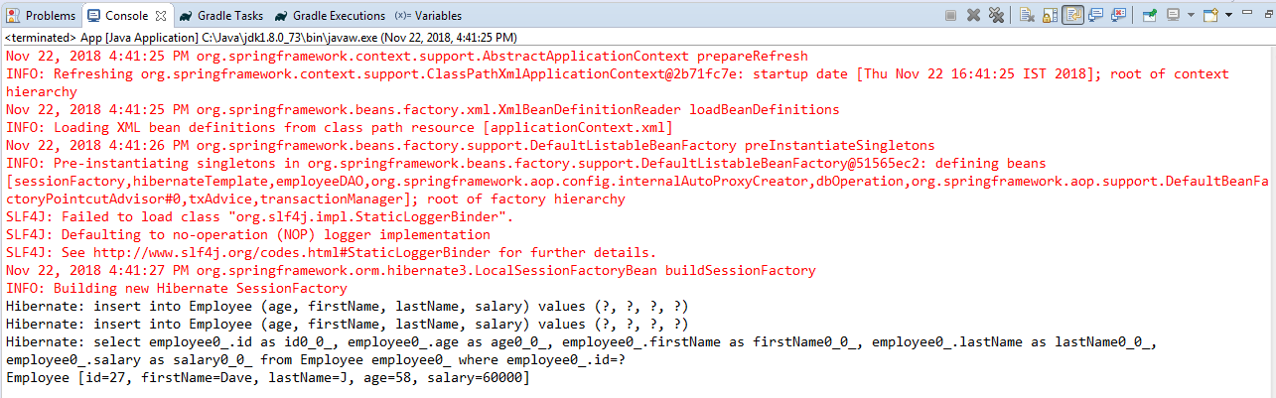
Spring Hibernate Integration Example

